Slide 1
GAM 325/425: Applied 3D Geometry
Lecture 4, Part C: (Extra Topics)
Converting Rotations From Matrix Form to Euler Angles

Slide 2
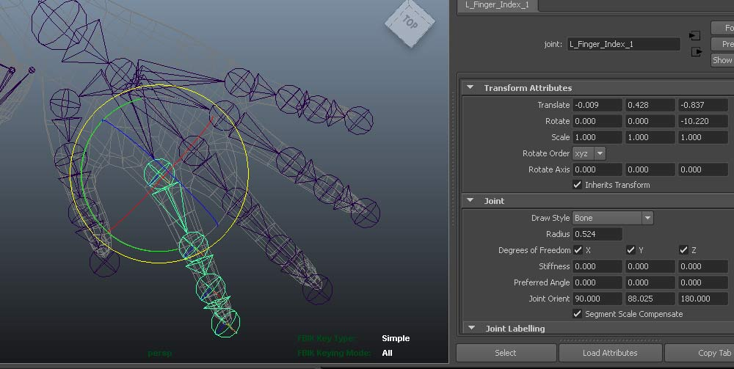
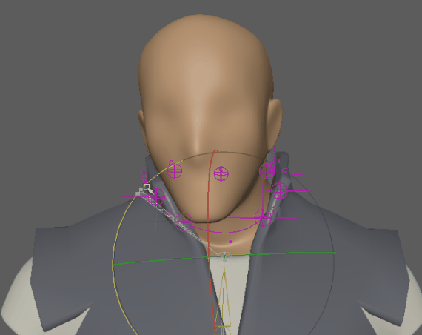
Problem: Convert Rotation Matrix to Euler Angles
Problem: You have an object positioned in space with a matrix W = TRS and you need to extract the Euler angles from R to position the rotation widgets for a GUI.
What are the angles based on the rotation widget?

Slide 3
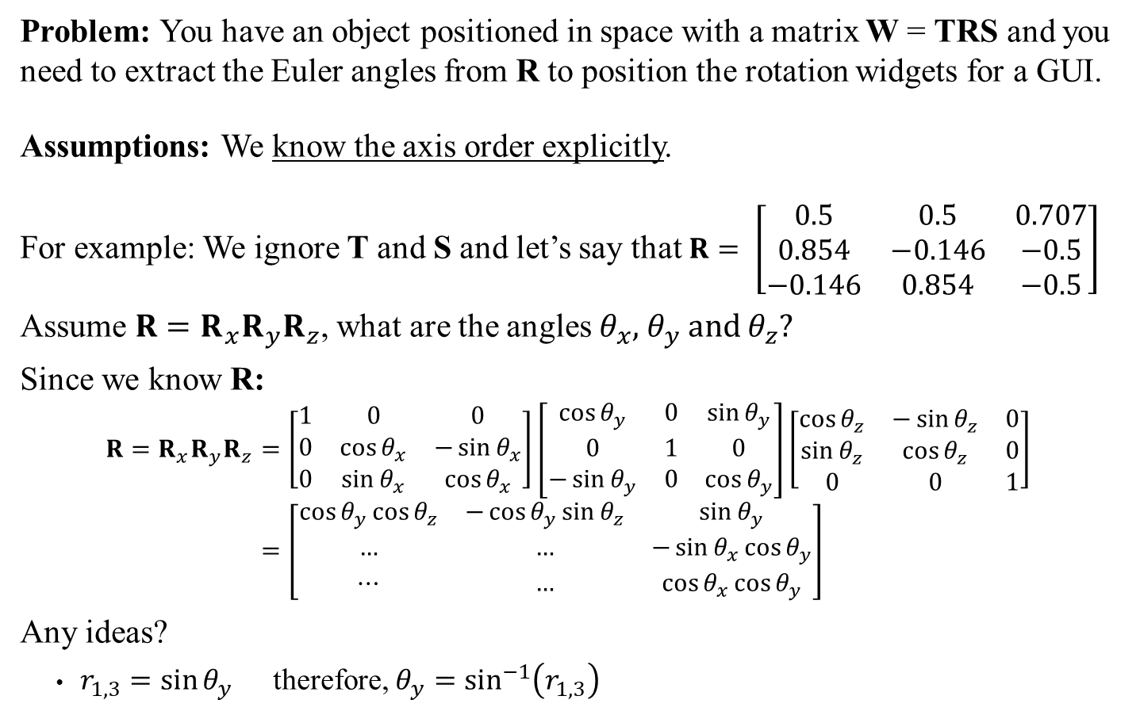
Problem: Convert Rotation Matrix to Euler Angles
Problem: You have an object positioned in space with a matrix W = TRS and you need to extract the Euler angles from R to position the rotation widgets for a GUI.
Assumptions: We know the axis order explicitly.
For example: We ignore T and S and let’s say that $R= \left[\begin{matrix}0.5 & 0.5 & 0.707 \\ 0.854 & −0.146 & −0.5 \\ −0.146 & 0.854 & −0.5\end{matrix}\right]$
Assume $R=R_{x}R_{y}R_{z}$, what are the angles $θ_{x}$, $θ_{y}$ and $θ_{z}$?
Since we know R:
$$R=R_{x}R_{y}R_{z}=\left[\begin{matrix}1 & 0 & 0 \\ 0 & \cos{θ_{x}} & −\sin{θ_{x}} \\ 0 & \sin{θ_{x}} & \cos{θ_{x}}\end{matrix}\right]\left[\begin{matrix}\cos{θ_{y}} & 0 & \sin{θ_{y}} \\ 0 & 1 & 0 \\ −\sin{θ_{y}} & 0 & \cos{θ_{y}}\end{matrix}\right]\left[\begin{matrix}\cos{θ_{z}} & −\sin{θ_{z}} & 0 \\ \sin{θ_{z}} & \cos{θ_{z}} & 0 \\ 0 & 0 & 1\end{matrix}\right] \\ =\left[\begin{matrix}\cos{θ_{y}}\cos{θ_{z}} & −\cos{θ_{y}}\sin{θ_{z}} & \sin{θ_{y}} \\ … & … & −\sin{θ_{x}}\cos{θ_{y}} \\ ⋯ & … & \cos{θ_{x}}\cos{θ_{y}}\end{matrix}\right]$$
Any ideas?
$r_{1,3}=\sin{θ_{y}}$ therefore, $θ_{y}=\sin^{−1}\left(r_{1,3}\right)$
If the axis order is not known, the problem is not solvable

Slide 4
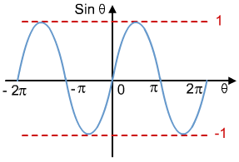
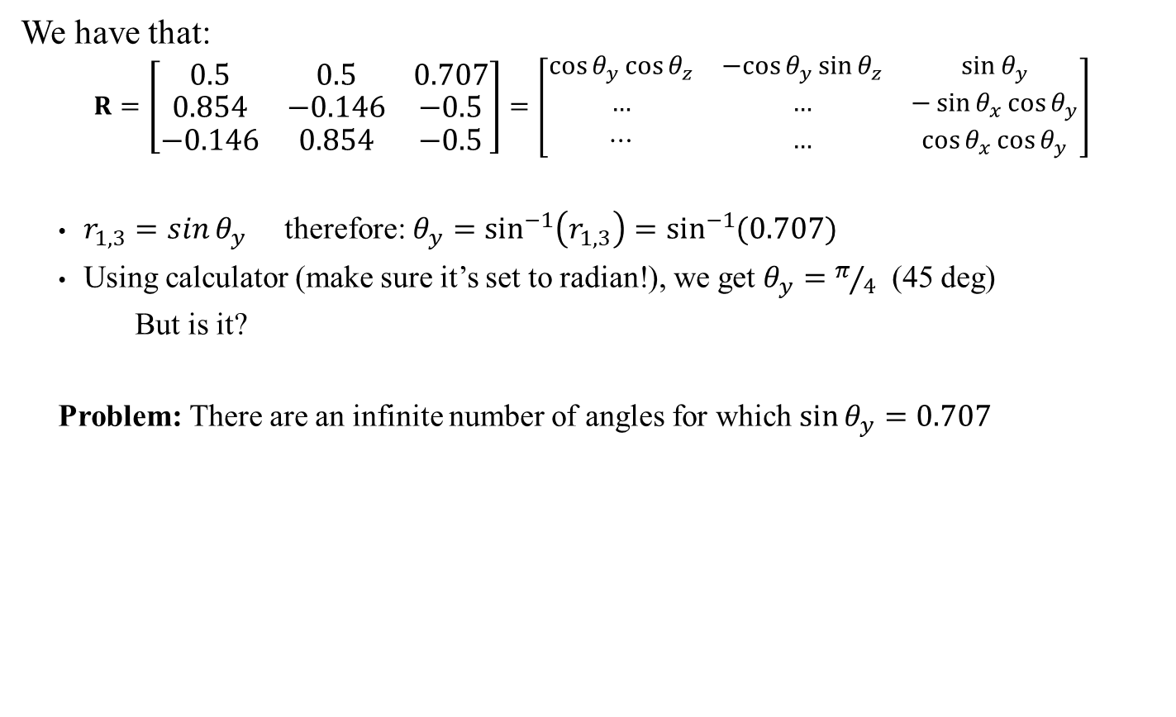
Problem: Convert Rotation Matrix to Euler Angles
We have that:
$$R=\left[\begin{matrix}0.5 & 0.5 & 0.707 \\ 0.854 & −0.146 & −0.5 \\ −0.146 & 0.854 & −0.5\end{matrix}\right]=\left[\begin{matrix}\cos{θ_{y}}\cos{θ_{z}} & −cos{θ_{y}}\sin{θ_{z}} & \sin{θ_{y}} \\ … & … & −\sin{θ_{x}}\cos{θ_{y}} \\ ⋯ & … & \cos{θ_{x}}\cos{θ_{y}}\end{matrix}\right]$$
$r_{1,3}=\sin{θ_{y}}$ therefore: $θ_{y}=\sin^{−1}\left(r_{1,3}\right)=\sin^{−1}{(0.707)}$
Using calculator (make sure it’s set to radian!), we get $θ_{y}=π/4$ (45 deg)
But is it?
Problem: There are an infinite number of angles for which $\sin{θ_{y}}=0.707$
0.707

Slide 5
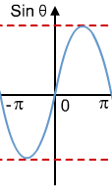
Trigonometric Functions and Their inverses
When dealing with angles in general, we usually limit the range of options to one full circles. Typically this means one of these ranges: [0, 2π] or [-π, π]
We’ll be using [-π, π] but everything we do here could be adapted to [0, 2π]
Problem: Even on the restricted range [-π, π], inverting the sine function still offers two possible angle for the same sine value…
0.707
And of course, the same is true for Cosine, Tangent, etc.

Slide 6
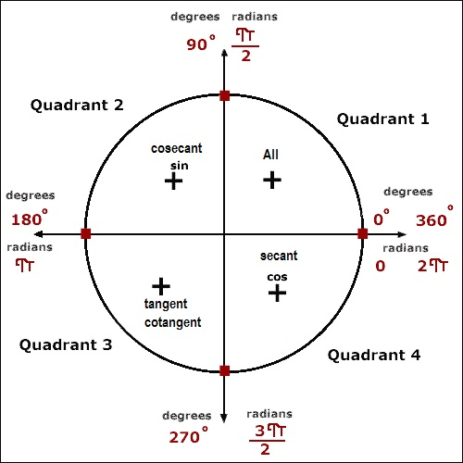
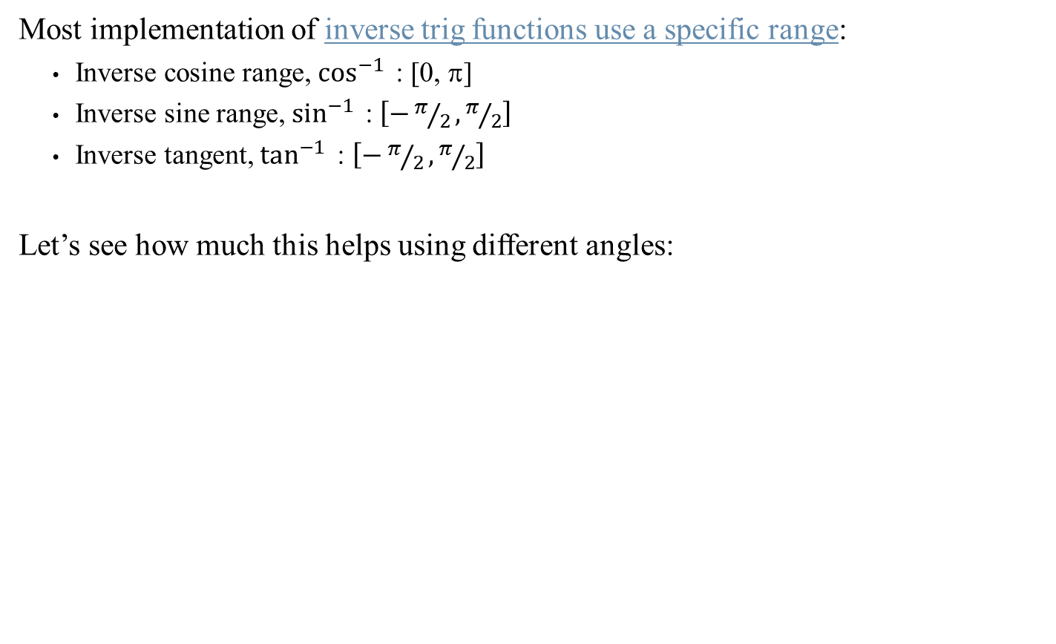
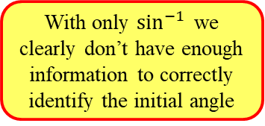
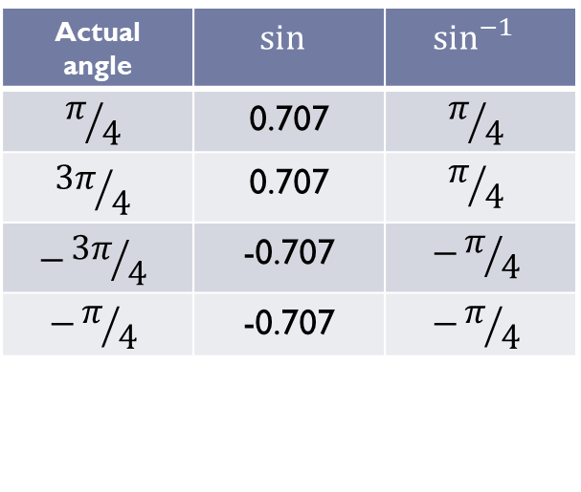
Trigonometric Functions and Their inverses
Most implementation of inverse trig functions use a specific range:
Inverse cosine range, $\cos^{−1}{ }$: [0, π]
Inverse sine range, $\sin^{−1}{ }$: $\left[−π/2,π/2\right]$
Inverse tangent, $\tan^{−1}{ }$: $\left[−π/2,π/2\right]$
Let’s see how much this helps using different angles:
Sidebar:
Inverse trigonometric functions are also called arcsine, arccosine, arctangent etc. Giving us the alternate notation acos, asin, etc.
Actual angle | $$\sin{ }$$ | $$\sin^{−1}{ }$$
$$π/4$$ | 0.707 | $$π/4$$
$${3π}/4$$ | 0.707 | $$π/4$$
$$−{3π}/4$$ | -0.707 | $$−π/4$$
$$−π/4$$ | -0.707 | $$−π/4$$
With only $\sin^{−1}{ }$we clearly don’t have enough information to correctly identify the initial angle

Slide 7
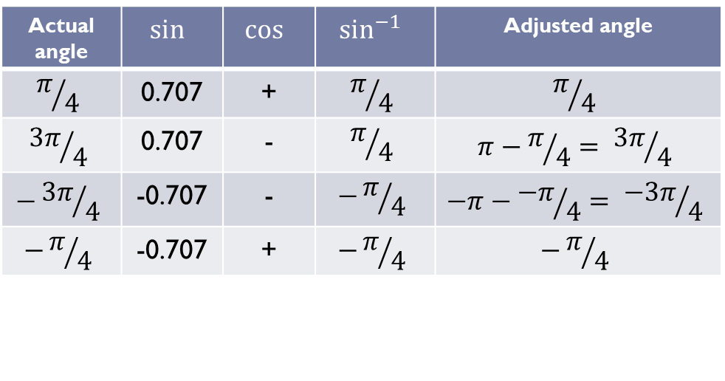
Trigonometric Functions and Their inverses
What if we considered sine and cosine jointly?
In general: seeing both values of sine and cosine (specifically, their +/- signs) allows us to determine the proper quadrant of the angle and therefore correctly adjust the answer we get from inverse trigs.
It’s a bit fiddly though… Fortunately, somebody did the work for us…
Actual angle | $$\sin{ }$$ | $$\cos{ }$$ | $$\sin^{−1}{ }$$ | Adjusted angle
$$π/4$$ | 0.707 | + | $$π/4$$ | $$π/4$$
$${3π}/4$$ | 0.707 | - | $$π/4$$ | $$π−π/4= {3π}/4$$
$$−{3π}/4$$ | -0.707 | - | $$−π/4$$ | $$−π−{−π}/4= {−3π}/4$$
$$−π/4$$ | -0.707 | + | $$−π/4$$ | $$−π/4$$

Slide 8
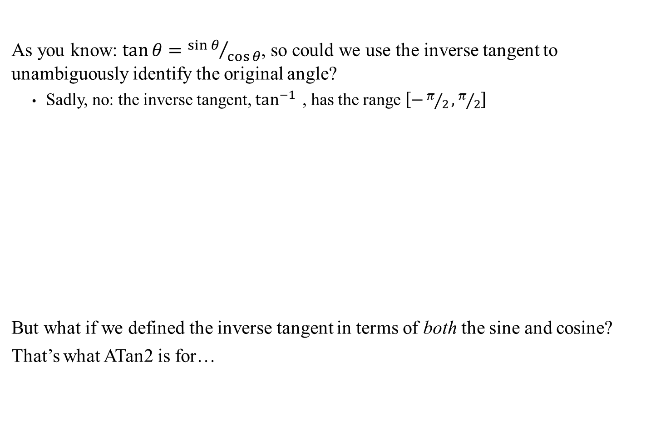
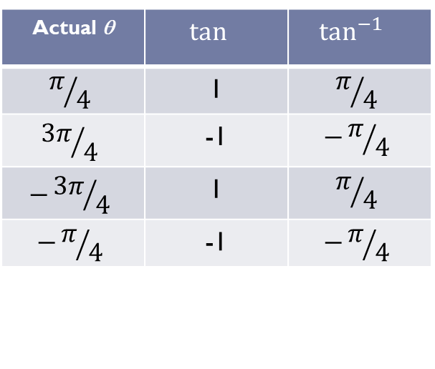
Inverse Tangent and ATan2
As you know: $\tan{θ}={\sin{θ}}/{\cos{θ}}$, so could we use the inverse tangent to unambiguously identify the original angle?
Sadly, no: the inverse tangent, $\tan^{−1}{ }$, has the range $\left[−π/2,π/2\right]$
But what if we defined the inverse tangent in terms of both the sine and cosine?
That’s what ATan2 is for…
Actual θ | $$\tan{ }$$ | $$\tan^{−1}{ }$$
$$π/4$$ | 1 | $$π/4$$
$${3π}/4$$ | -1 | $$−π/4$$
$$−{3π}/4$$ | 1 | $$π/4$$
$$−π/4$$ | -1 | $$−π/4$$
Again, we are losing the quadrant information

Slide 9
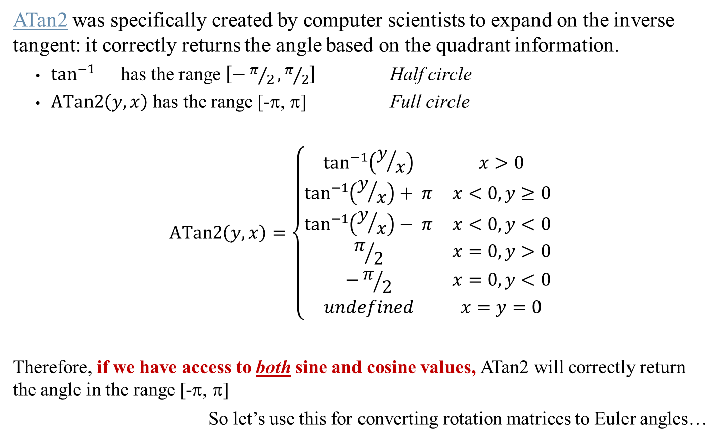
Inverse Tangent and ATan2
ATan2 was specifically created by computer scientists to expand on the inverse tangent: it correctly returns the angle based on the quadrant information.
$\tan^{−1}{}$ has the range $\left[−π/2,π/2\right]$ Half circle
$ATan2\left(y,x\right)$ has the range [-π, π] Full circle
$$ATan2\left(y,x\right)=\left\{\begin{matrix}\tan^{−1}\left(y/x\right) & x>0 \\ \tan^{−1}\left(y/x\right)+ π & x<0, y≥0 \\ \tan^{−1}\left(y/x\right)− π & x<0, y<0 \\ π/2 & x=0, y>0 \\ −π/2 & x=0,y<0 \\ undefined & x=y=0\end{matrix}\right.$$
Therefore, if we have access to both sine and cosine values, ATan2 will correctly return the angle in the range [-π, π]
So let’s use this for converting rotation matrices to Euler angles…
Quadrant 1 and 4
Quadrant 2
Quadrant 3
Corrects for division by 0
Varies by implementation
See also Dynamic Examples

Slide 10
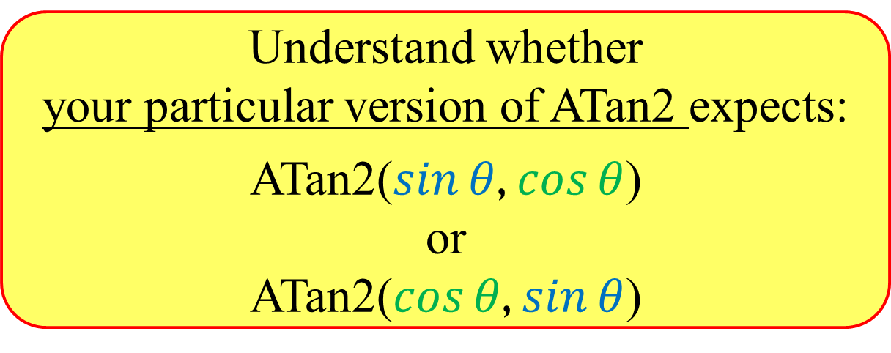
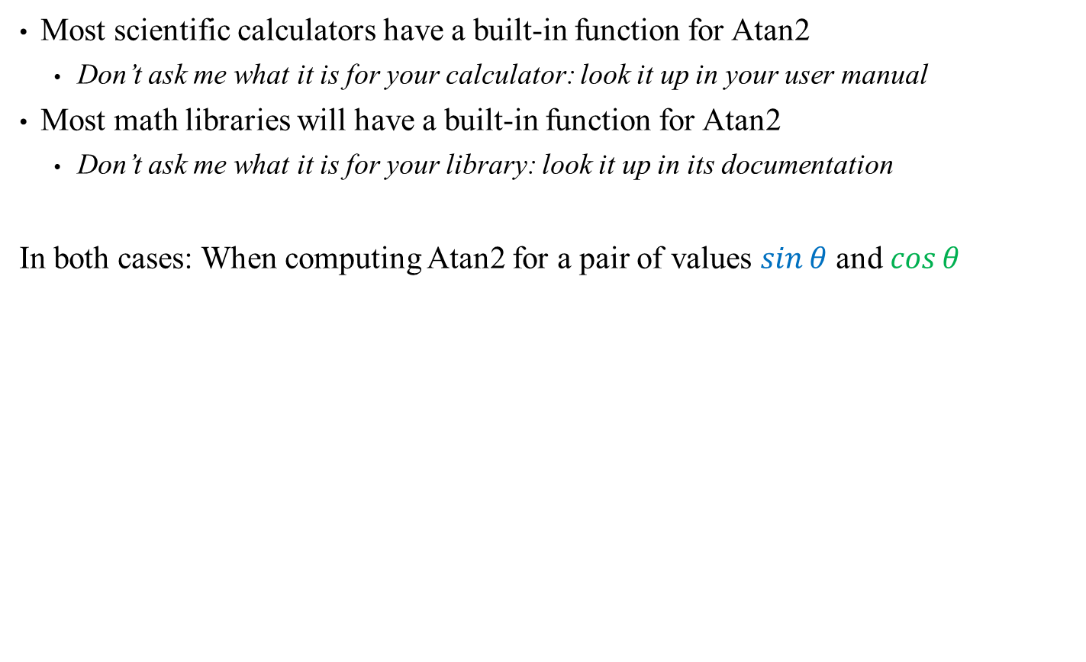
*** ATAN2 USAGE WARNING! ***
Most scientific calculators have a built-in function for Atan2
Don’t ask me what it is for your calculator: look it up in your user manual
Most math libraries will have a built-in function for Atan2
Don’t ask me what it is for your library: look it up in its documentation
In both cases: When computing Atan2 for a pair of values $\sin{θ}$ and $\cos{θ}$
Understand whether your particular version of ATan2 expects:
ATan2($\sin{θ}$, $\cos{θ}$) or
ATan2($\cos{θ}$, $\sin{θ}$)

Slide 11
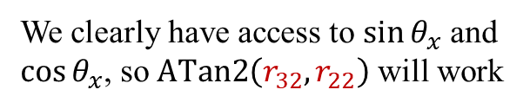
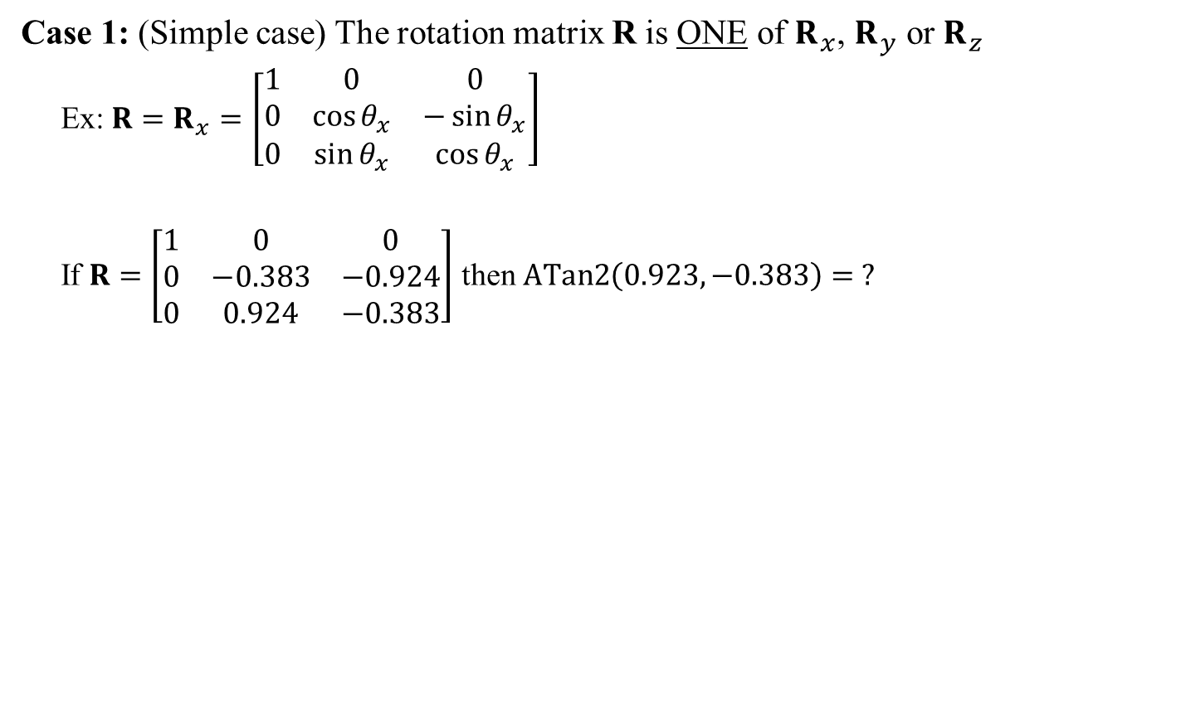
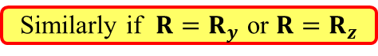
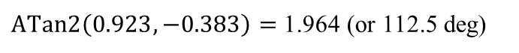
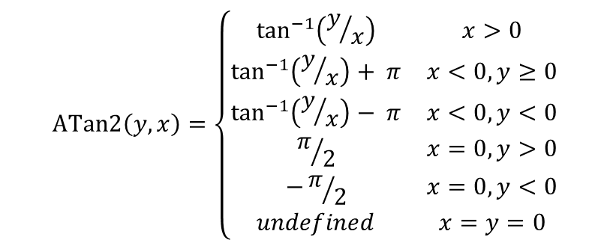
Convert Rotation Matrix to Euler Angles
Case 1: (Simple case) The rotation matrix R is ONE of $R_{x}$, $R_{y}$ or $R_{z}$
Ex: $R=R_{x}=\left[\begin{matrix}1 & 0 & 0 \\ 0 & \cos{θ_{x}} & −\sin{θ_{x}} \\ 0 & \sin{θ_{x}} & \cos{θ_{x}}\end{matrix}\right]$
If $R=\left[\begin{matrix}1 & 0 & 0 \\ 0 & −0.383 & −0.924 \\ 0 & 0.924 & −0.383\end{matrix}\right]$ then $ATan2\left(0.923, −0.383\right)= ?$
We clearly have access to $\sin{θ_{x}}$ and $\cos{θ_{x}}$, so $ATan2\left(r_{32},r_{22}\right)$ will work
Similarly if $R=R_{y}$ or $R=R_{z}$
$$ATan2\left(y,x\right)=\left\{\begin{matrix}\tan^{−1}\left(y/x\right) & x>0 \\ \tan^{−1}\left(y/x\right)+ π & x<0, y≥0 \\ \tan^{−1}\left(y/x\right)− π & x<0, y<0 \\ π/2 & x=0, y>0 \\ −π/2 & x=0,y<0 \\ undefined & x=y=0\end{matrix}\right.$$
$ATan2\left(0.923, −0.383\right)=$ 1.964 (or 112.5 deg)

Slide 12
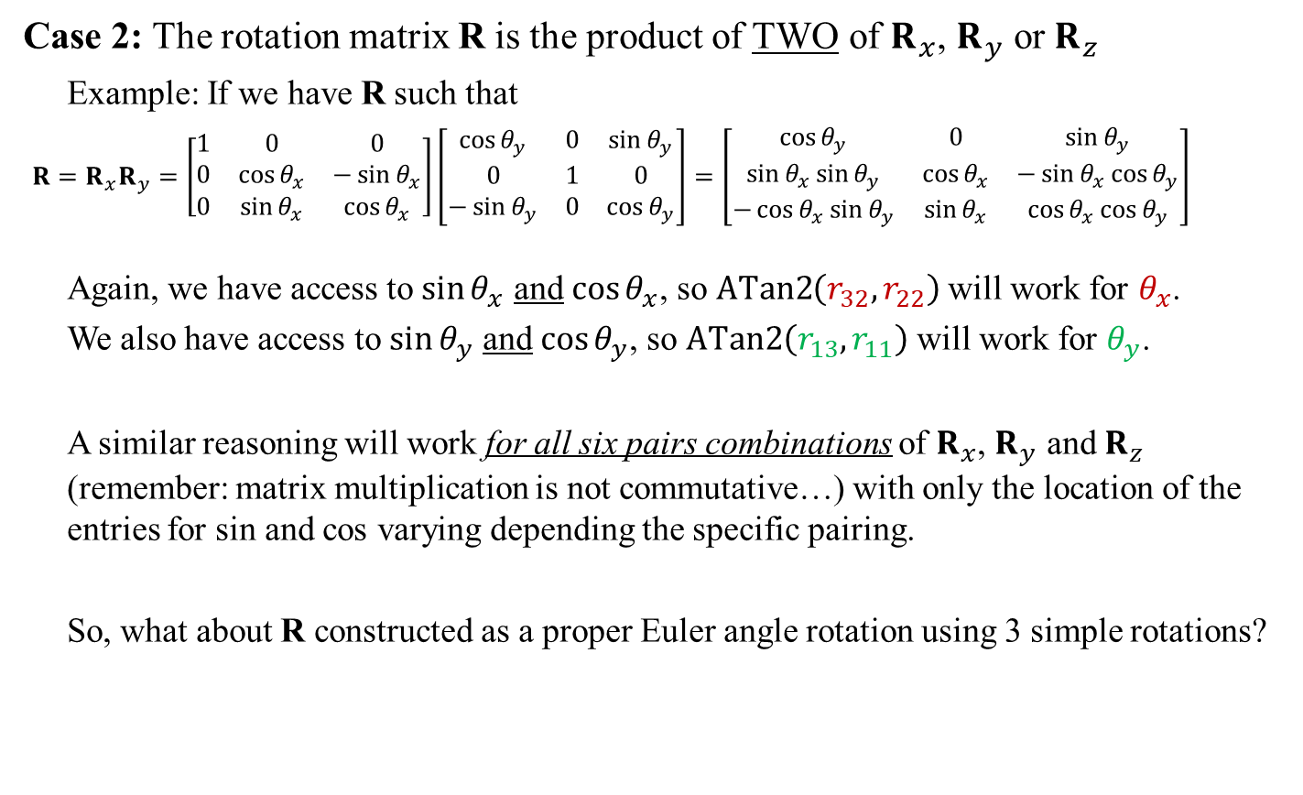
Convert Rotation Matrix to Euler Angles
Case 2: The rotation matrix R is the product of TWO of $R_{x}$, $R_{y}$ or $R_{z}$
Example: If we have R such that
$R=R_{x}R_{y}=\left[\begin{matrix}1 & 0 & 0 \\ 0 & \cos{θ_{x}} & −\sin{θ_{x}} \\ 0 & \sin{θ_{x}} & \cos{θ_{x}}\end{matrix}\right]\left[\begin{matrix}\cos{θ_{y}} & 0 & \sin{θ_{y}} \\ 0 & 1 & 0 \\ −\sin{θ_{y}} & 0 & \cos{θ_{y}}\end{matrix}\right]=\left[\begin{matrix}\cos{θ_{y}} & 0 & \sin{θ_{y}} \\ \sin{θ_{x}}\sin{θ_{y}} & \cos{θ_{x}} & −\sin{θ_{x}}cos{θ_{y}} \\ −\cos{θ_{x}}\sin{θ_{y}} & \sin{θ_{x}} & \cos{θ_{x}}cos{θ_{y}}\end{matrix}\right]$
Again, we have access to $\sin{θ_{x}}$ and $\cos{θ_{x}}$, so $ATan2\left(r_{32},r_{22}\right)$ will work for $θ_{x}$.
We also have access to $\sin{θ_{y}}$ and $\cos{θ_{y}}$, so $ATan2\left(r_{13},r_{11}\right)$ will work for $θ_{y}$.
A similar reasoning will work for all six pairs combinations of $R_{x}$, $R_{y}$ and $R_{z}$ (remember: matrix multiplication is not commutative…) with only the location of the entries for sin and cos varying depending the specific pairing.
So, what about R constructed as a proper Euler angle rotation using 3 simple rotations?

Slide 13
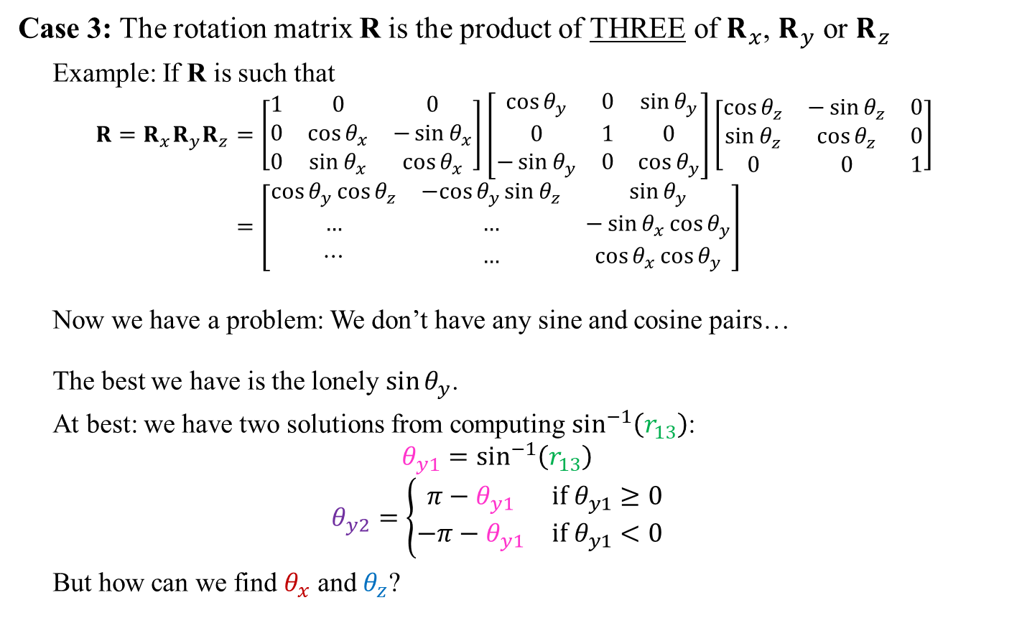
Convert Rotation Matrix to Euler Angles
Case 3: The rotation matrix R is the product of THREE of $R_{x}$, $R_{y}$ or $R_{z}$
Example: If R is such that
$$R=R_{x}R_{y}R_{z}=\left[\begin{matrix}1 & 0 & 0 \\ 0 & \cos{θ_{x}} & −\sin{θ_{x}} \\ 0 & \sin{θ_{x}} & \cos{θ_{x}}\end{matrix}\right]\left[\begin{matrix}\cos{θ_{y}} & 0 & \sin{θ_{y}} \\ 0 & 1 & 0 \\ −\sin{θ_{y}} & 0 & \cos{θ_{y}}\end{matrix}\right]\left[\begin{matrix}\cos{θ_{z}} & −\sin{θ_{z}} & 0 \\ \sin{θ_{z}} & \cos{θ_{z}} & 0 \\ 0 & 0 & 1\end{matrix}\right] \\ =\left[\begin{matrix}\cos{θ_{y}}\cos{θ_{z}} & −cos{θ_{y}}\sin{θ_{z}} & \sin{θ_{y}} \\ … & … & −\sin{θ_{x}}\cos{θ_{y}} \\ ⋯ & … & \cos{θ_{x}}\cos{θ_{y}}\end{matrix}\right]$$
Now we have a problem: We don’t have any sine and cosine pairs…
The best we have is the lonely $\sin{θ_{y}}$.
At best: we have two solutions from computing $\sin^{−1}\left(r_{13}\right)$:
$$θ_{y1}=\sin^{−1}\left(r_{13}\right)$$
$$θ_{y2}=\left\{\begin{matrix}π−θ_{y1} & \text{if} θ_{y1}≥0 \\ −π−θ_{y1} & \text{if} θ_{y1}<0\end{matrix}\right.$$
But how can we find $θ_{x}$ and $θ_{z}$?
Keeps the angle in the range [-π, π]

Slide 14
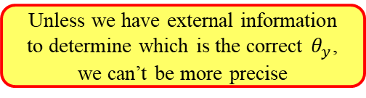
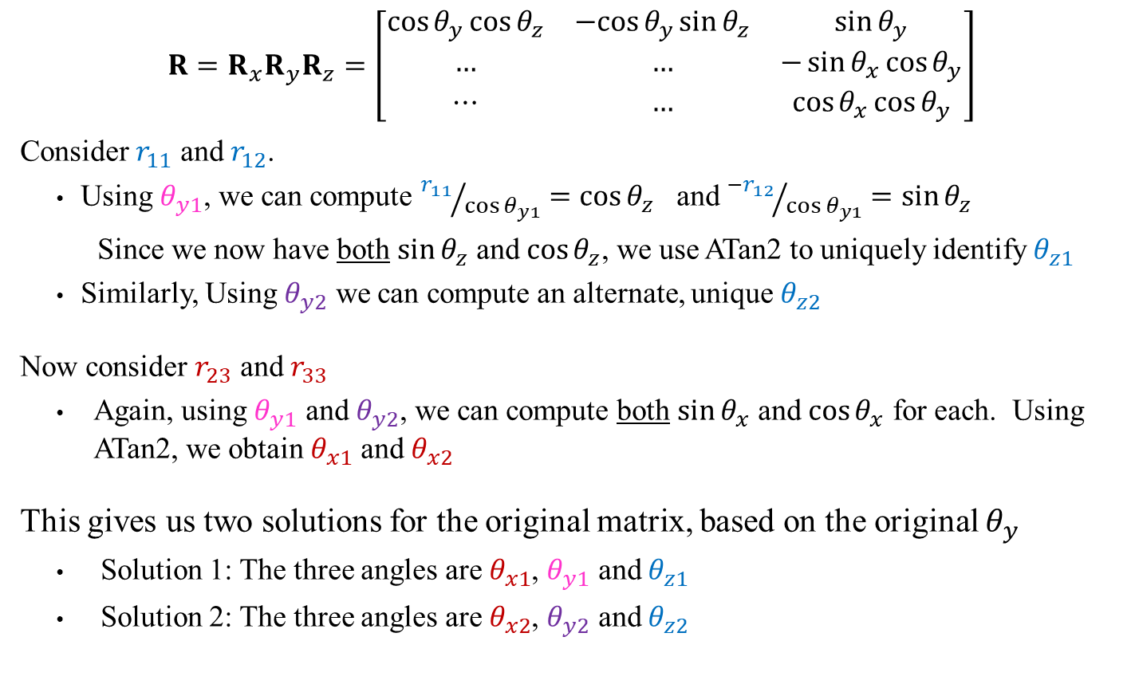
Convert Rotation Matrix to Euler Angles
$$R=R_{x}R_{y}R_{z}=\left[\begin{matrix}\cos{θ_{y}}\cos{θ_{z}} & −cos{θ_{y}}\sin{θ_{z}} & \sin{θ_{y}} \\ … & … & −\sin{θ_{x}}\cos{θ_{y}} \\ ⋯ & … & \cos{θ_{x}}\cos{θ_{y}}\end{matrix}\right]$$
Consider $r_{11}$ and $r_{12}$.
Using $θ_{y1}$, we can compute ${r_{11}}/{\cos{θ_{y1}}}=\cos{θ_{z}}$ and ${−r_{12}}/{\cos{θ_{y1}}}=\sin{θ_{z}}$
Since we now have both $\sin{θ_{z}}$ and $\cos{θ_{z}}$, we use ATan2 to uniquely identify $θ_{z1}$
Similarly, Using $θ_{y2}$ we can compute an alternate, unique $θ_{z2}$
Now consider $r_{23}$ and $r_{33}$
Again, using $θ_{y1}$ and $θ_{y2}$, we can compute both $\sin{θ_{x}}$ and $\cos{θ_{x}}$ for each. Using ATan2, we obtain $θ_{x1}$ and $θ_{x2}$
This gives us two solutions for the original matrix, based on the original $θ_{y}$
Solution 1: The three angles are $θ_{x1}$, $θ_{y1}$ and $θ_{z1}$
Solution 2: The three angles are $θ_{x2}$, $θ_{y2}$ and $θ_{z2}$
Unless we have external information to determine which is the correct $θ_{y}$, we can’t be more precise

Slide 15
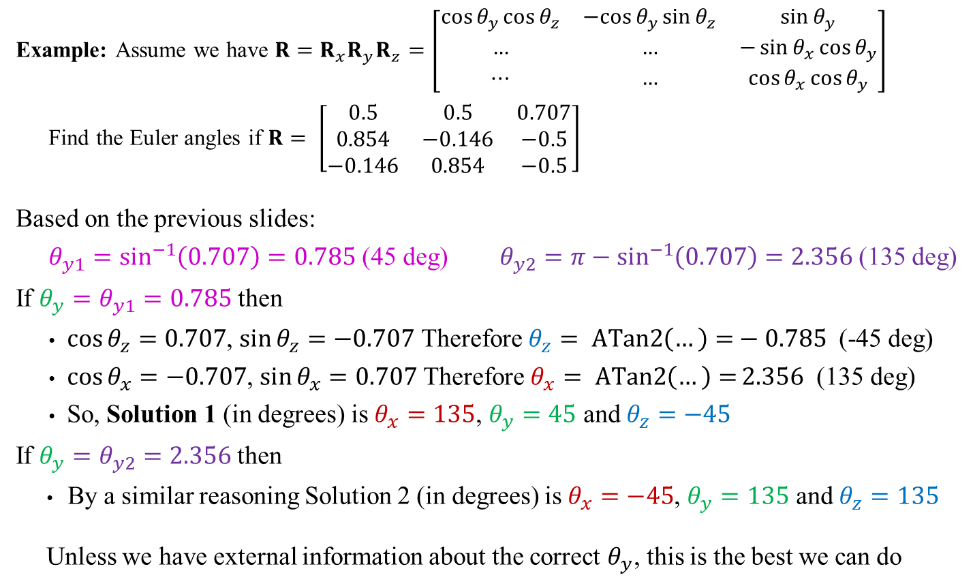
Convert Rotation Matrix to Euler Angles
Example: Assume we have $R=R_{x}R_{y}R_{z}=\left[\begin{matrix}\cos{θ_{y}}\cos{θ_{z}} & −cos{θ_{y}}\sin{θ_{z}} & \sin{θ_{y}} \\ … & … & −\sin{θ_{x}}\cos{θ_{y}} \\ ⋯ & … & \cos{θ_{x}}\cos{θ_{y}}\end{matrix}\right]$
Find the Euler angles if $R= \left[\begin{matrix}0.5 & 0.5 & 0.707 \\ 0.854 & −0.146 & −0.5 \\ −0.146 & 0.854 & −0.5\end{matrix}\right]$
Based on the previous slides:
$θ_{y1}=\sin^{−1}\left(0.707\right)=0.785$ (45 deg) $θ_{y2}=π−\sin^{−1}\left(0.707\right)=2.356$ (135 deg)
If $θ_{y}=θ_{y1}=0.785$ then
$\cos{θ_{z}}=0.707$, $\sin{θ_{z}}=−0.707$ Therefore $θ_{z}= ATan2\left(…\right)=−0.785$ (-45 deg)
$\cos{θ_{x}}=−0.707$, $\sin{θ_{x}}=0.707$ Therefore $θ_{x}= ATan2\left(…\right)=2.356$ (135 deg)
So, Solution 1 (in degrees) is $θ_{x}=135$, $θ_{y}=45$ and $θ_{z}=−45$
If $θ_{y}=θ_{y2}=$ $2.356$ then
By a similar reasoning Solution 2 (in degrees) is $θ_{x}=−45$, $θ_{y}=135$ and $θ_{z}=135$
Unless we have external information about the correct $θ_{y}$, this is the best we can do

Slide 16
Conclusions
Extracting Euler angles from a Rotation matrix is possible IF:
You limit those angles to a specific range (we used [-π, π], fairly common)
You know exactly the order of the 3 axes for the rotation
For each specific 3-axis order there is a different set of operations to extract the three angles.
You must multiply the three rotations symbolically and determine the best approach.
The general algorithm is the same in each case, but which entries to use will vary.
At best there are still two possible solutions for each given rotation matrix (infinite if there is a gimble lock).
Computing the angles rely heavily on using the ATan2 function
This lecture is heavily inspired from “Computing Euler angles from a rotation matrix” by G. G. Slabaugh. I recommend reading it!

